Slide 1
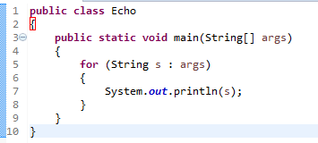
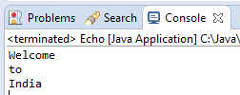

Command-Line Arguments
A Java application can accept any number of arguments from the command line. This allows the user to specify configuration information when the application is launched.
Java Echo Welcome to India
When an application is launched, the runtime system passes the command-line arguments to the application's main method via an array of Strings.
The space character separates command-line arguments.
Java Echo Welcome to India
To have Welcome, to and India interpreted as a single argument, the user would join them by enclosing them within quotation marks.
Java Echo “Welcome to India”

